Slide 1
Lecture 13 Tables and Hashing

Slide 2
Outline
Introduction
Rectangular Tables
Hash Tables
Analysis of Hashing
Comparison of Methods

Slide 3
Introduction: Breaking the lg n Barrier
By use of key comparisons alone, it is impossible to complete a search of n items in fewer than lg n comparisons, on average.
Ordinary table lookup or array access requires only constant time O(1).
Both table lookup and searching share the same essential purpose, that of information retrieval. The key used for searching and the index used for table lookup have the same essential purpose: one piece of information that is used to locate further information.
Both table lookup and searching algorithms provide functions from a set of keys or indices to locations in a list or array.

Slide 4
Introduction: Breaking the lg n Barrier
We study ways to implement and access various kinds of tables in contiguous storage.
Several steps may be needed to retrieve an entry from some kinds of tables, but the time required remains O(1). It is bounded by a constant that does not depend on the size of the table. Thus table lookup can be more efficient than any searching method.
We look at methods for information retrieval using various tables, from rectangular tables to hash tables.

Slide 5
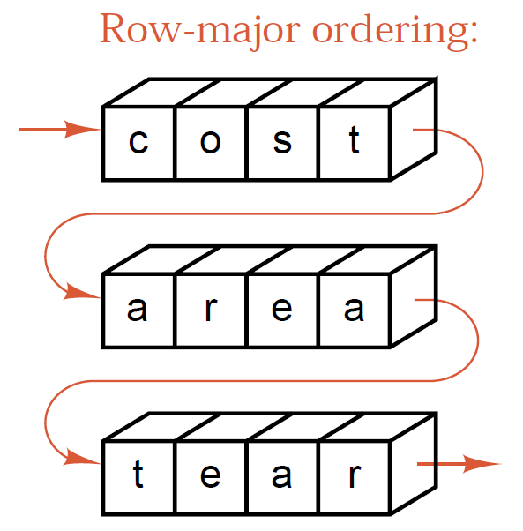
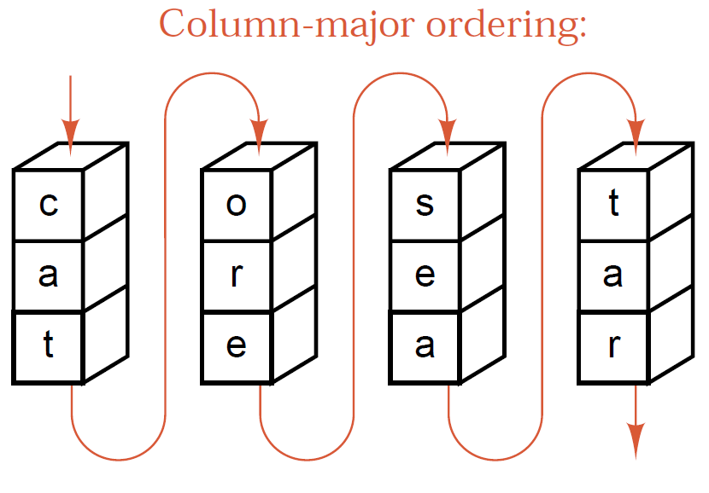
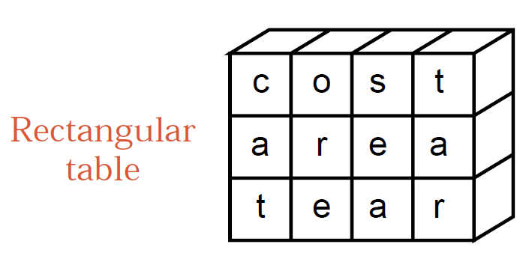
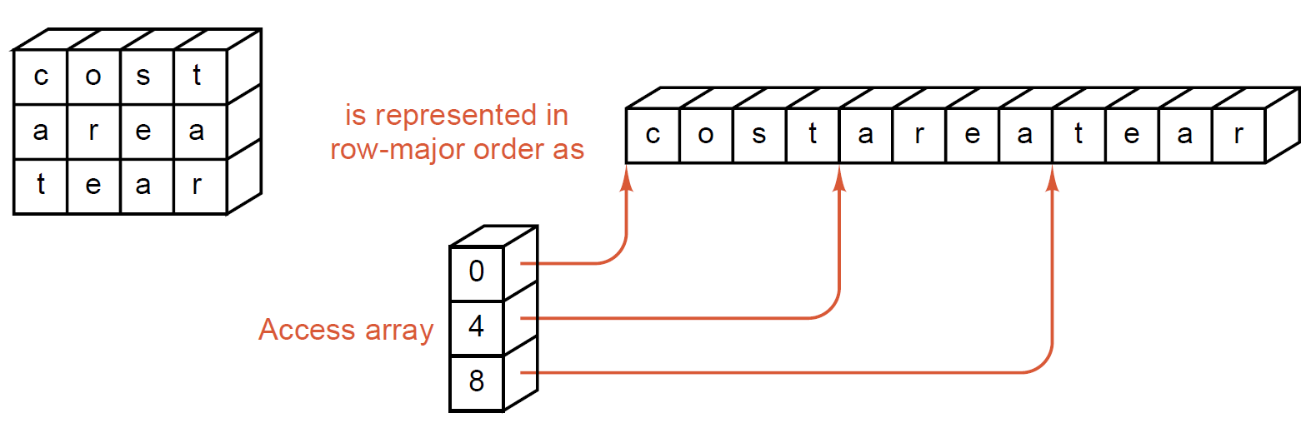
Rectangular Arrays
Suppose that the rectangular array has m rows n columns.
In row-major ordering, entry [i, j] goes to position ni + j.
In column-major ordering, entry [i, j] goes to position i + mj.

Slide 6
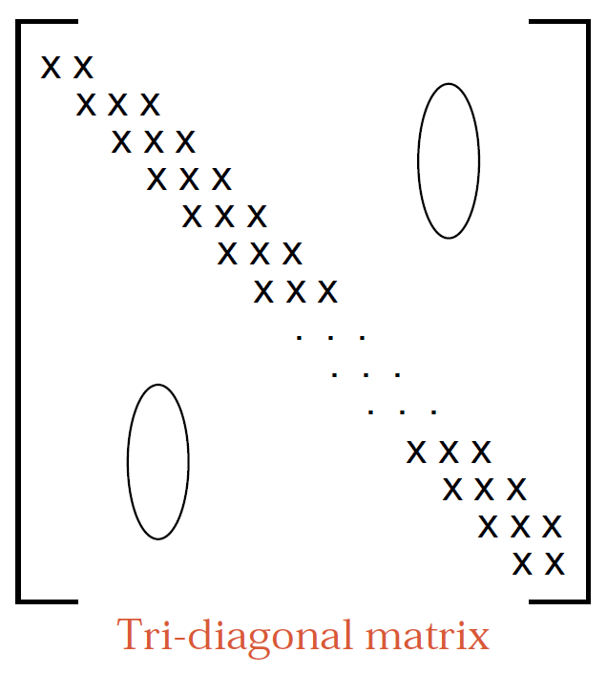
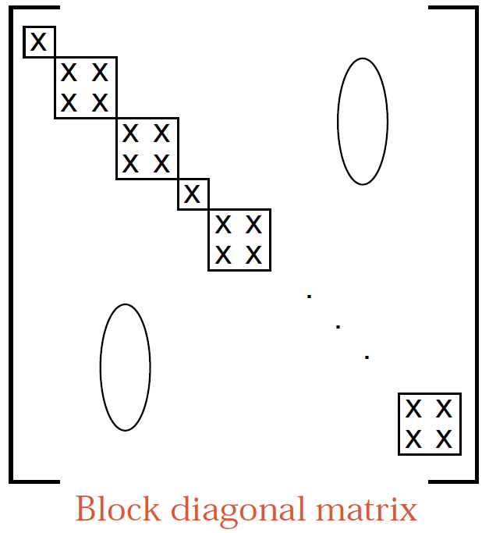
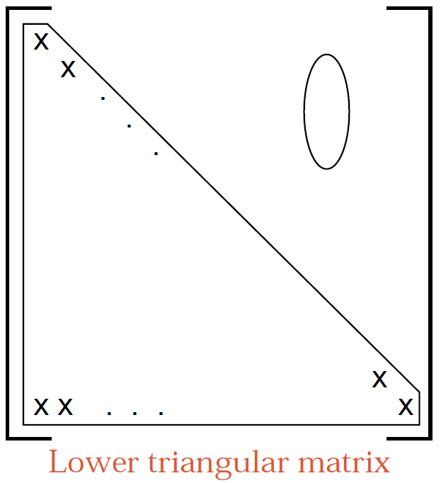
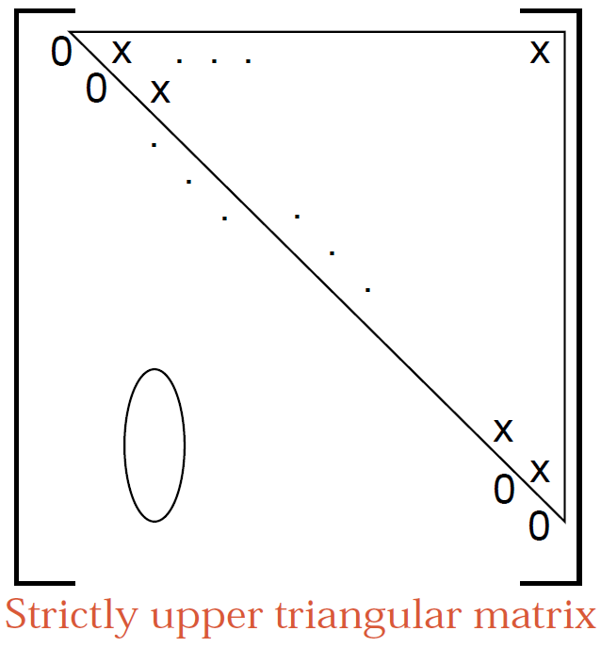
Matrices of Various Shapes
对角矩阵：三对角矩阵、块状对角矩阵
三角矩阵：上/下三角矩阵、严格上/下三角矩阵
对称矩阵

Slide 7
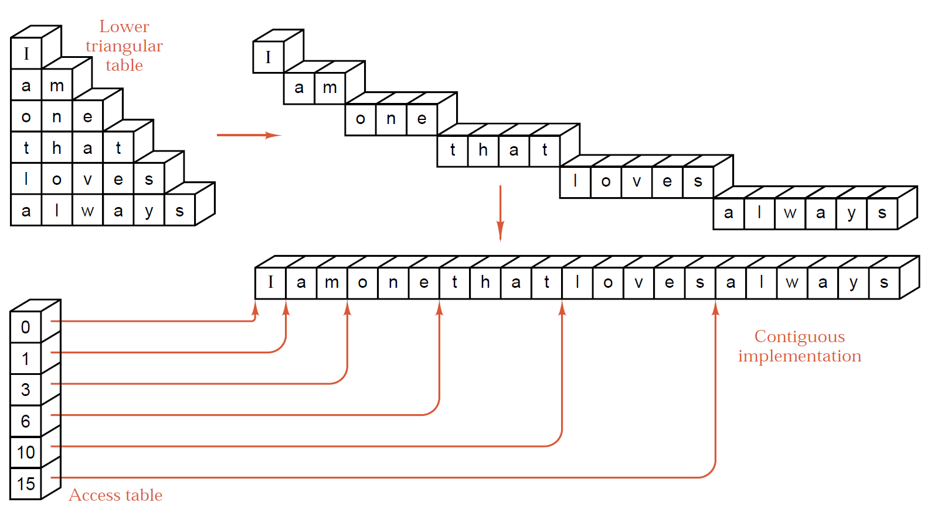
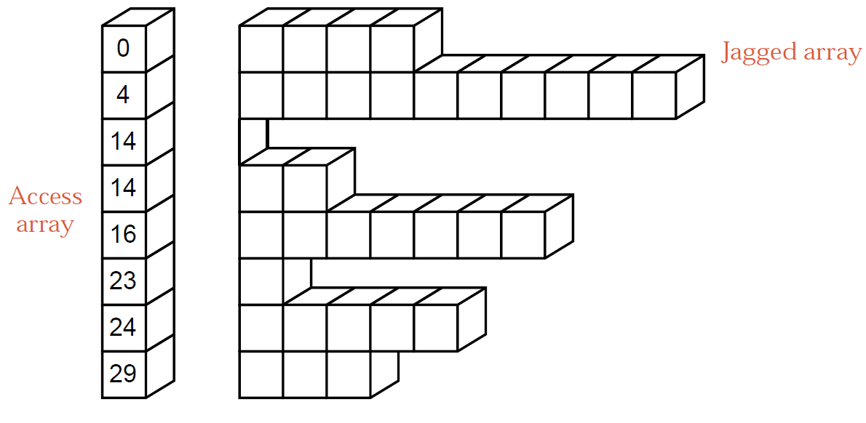
Contiguous Implementation of Rectangular Tables

Slide 8
Sparse Matrices
Sparse matrix is the type of 2-D matrix where a number of zero elements are large as compared to non-zero elements.
Use a triplet list to define the sparse matrix.
7
No. rows
8
No. columns
9
No. non-zero elements
0 12 9 0 0 0 0 0
1 2 12
0 0 0 0 0 0 0 0
1 3 9
3 1 -3
-3 0 0 0 0 0 0 4
3 8 4
A=
0 0 24 0 0 2 0 0
4 3 24
0 18 0 0 0 0 0 0
4 6 2
5 2 18
0 0 0 0 0 0 -7 0
6 7 -7
0 0 0 -6 0 0 0 0
7 4 -6
Sparse matrix
row
col
value

Slide 9
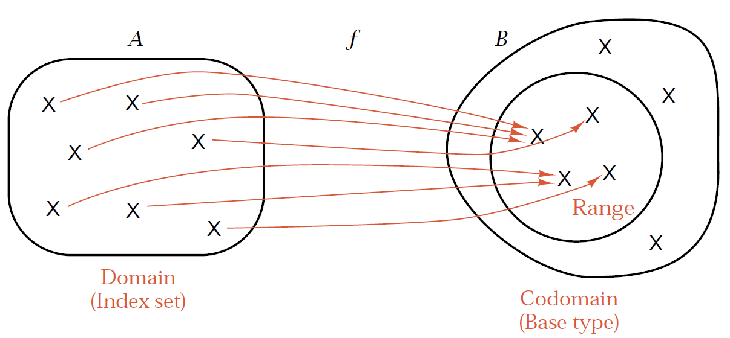
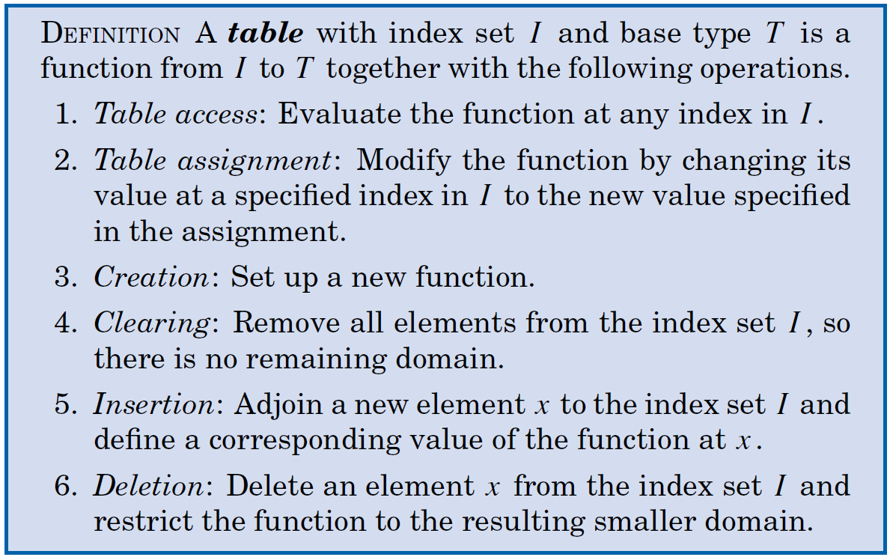
ADT Table
In mathematics a function is defined in terms of two sets and a correspondence from elements of the first set to elements of the second.
If f is a function from a set A to a set B, then f assigns to each element of A a unique element of B.

Slide 10
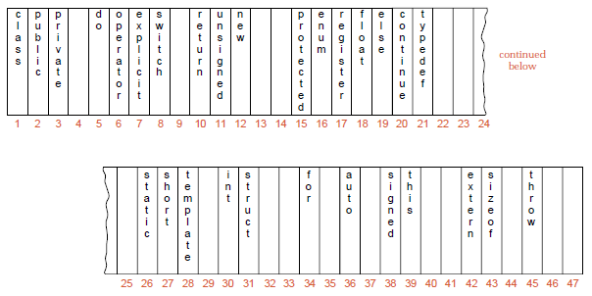
Hash Tables（哈希表/散列表）
Idea of Hashing:
A table can be indexed by a key.
If there is a function f: K → N, where K is the set of possible keys and N is the set of indices of an array, then we can store an entry with key K at the location f(K) and hence access a table entry becomes easy.

Slide 11
Hash Tables
The function f is called hash function(散列函数).
Hash tables (散列表): a table that is stored using hashing, a structure that can map keys to values.
We start with an array that holds the hash table.
Use a hash function to take a key and map it to some index in the array. This function will generally map several different keys to the same index.
If the desired record is in the location given by the index, then we are finished; otherwise we must use some method to resolve the collision that may have occurred between two records wanting to go to the same location.
To use hashing we must
(a) find good hash functions
(b) determine how to resolve collisions.

Slide 12
Constructing a Hash table
Initialization: declare an array that will hold the hash table.
Insertion: insert a record with key k into the hash table using hash function h,
The hash function for the key h(k) is computed.
If h(k) is empty, then the record is inserted; Otherwise,
If h(k) is not empty and the keys are different (a collision encountered), then find a new location for the record using the collision resolving method.
Retrieval:
The hash function for the key h(k) is computed.
If the location h(k) is empty, then the retrieval is unsuccessful;
If the corresponding location has the desired key, then the retrieval is successful, otherwise,
Follow the collision resolving method until an empty location is reached or the location has the desired key.

Slide 13
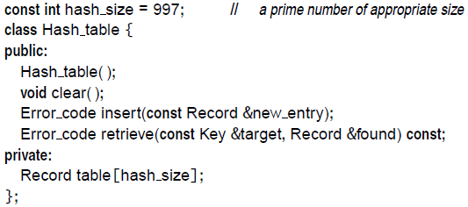
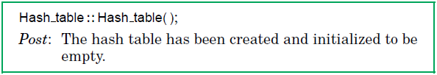

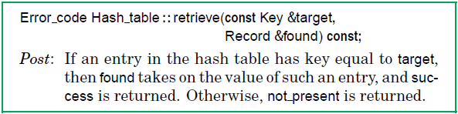
Hash Table Specifications

Slide 14
Choosing a Hash Function
A hash function should be easy and quick to compute.
A hash function should achieve an even distribution of the keys that actually occur across the range of indices.
The usual way to make a hash function is to take the key, chop it up, mix the pieces together in various ways, and thereby obtain an index that will be uniformly distributed over the range of indices.
Note that there is nothing random about a hash function. If the function is evaluated more than once on the same key, then it must give the same result every time, so the key can be retrieved without fail.
Notes:
要求一：n个数据原仅占用n个地址，虽然散列查找是以空间换时间，但仍希望散列的地址空间尽量小。
要求二：无论用什么方法存储，目的都是尽量均匀地存放元素，以避免冲突。

Slide 15
Hash Function Construction
常用的构造哈希函数的方法：
直接定址法
除留余数法 (Modular arithmetic)
平方取中法
折叠法 (Folding)
数字分析法
随机数法

Slide 16

Modular Arithmetic Method
Assume all keys are integers, and define
h(k) = k mod m.
Warning: Don’t pick an m that has a small divisor d. A preponderance(多数) of keys that are congruent(重叠) modulo d can adversely affect uniformity.
Example 1：给定一组关键字为:12,39,18,24,33,21，若取 m = 9,则他们对应的哈希函数值将为:3,3,0,6,6,3。可见，若p中含质因子3, 则所有含质因子 3的关键字均映射到“3的倍数”的地址上，从而增加了“冲突”的可能。
Example 2: If m = 2^{r}, then the hash doesn’t even depend on all the bits of k:

Slide 17
Modular Arithmetic Method
Hash Function: h(k) = k mod m.
Pick m to be a prime not too close to a power of 2 or 10.
Sometimes, when keys are not integers, try to convert them to integers. For example, how to convert the permutation (2,4,1,3) to a number? （康托展开，参见 http://baike.baidu.com/view/437641.htm ）
int PermutationToNumber(int permutation[]， int n) { int result = 0; for (int i = 0; i < n; i++) { int count = 0; for (int j = i + 1; j < n; j++) { if (permutation[j] < permutation[i]) count++; } // factorials[j]保存着j！ result += count * factorials[n - i - 1]; }
return result; }

Slide 18
Folding Method
We may partition the key into several parts and combine the parts in a convenient way.
例：关键码为 key=25346358705，设哈希表长为三位数，则可对关键码每三位一部分来分割。
对于位数很多的关键码，且每一位
上符号分布较均匀时，可采用此方
法求得哈希地址 。
253
463
587
＋ 05
1308
Hash(key)=308

Slide 19
Hash Functions for Strings
关键字为字符串时常用的hash函数
(1) 折叠法: 把所有字符的ASCII码相加
(2) 采用ELFhash函数
int ELFhash(char *key)
{
unsigned long h = 0;
while(*key){
h=(h<<4) + *key++;
unsigned long g = h & 0xf0000000L;
if (g) h^= g >> 24;
h &= ~g;
}
return h % m;
}

Slide 20
Choosing a Proper Hash Function
在实际应用中，应根据具体情况，灵活采用不同的方法，并用实际数据测试它的性能，以便做出正确判定。 通常应考虑以下五个因素：
计算哈希函数所需时间
关键字长度
哈希表长度（哈希地址范围）
关键字分布情况
记录的查找频率

Slide 21
Collision Resolution
Different keys may be mapped to the same index according to the hash function, incurring hash collisions.
To deal with collisions, there are generally two solutions:
(1) Open addressing（开发地址）
Linear Probing (线性探查)
Quadratic probing (二次探查)
(2) Chaining （链地址法或拉链法）

Slide 22
Collision Resolution with Open Addressing
When a collision occurs, form a sequence of addresses (探查序列) d₁, d₂, … using some method:
Insertion: search d1, d2, … one by one until an open address (empty unit) is found, the entry is inserted in the open address;
Retrieval: search d1, d2, … one by one until the desired record is found or an open address is found, the search is unsuccessful.

Slide 23
Linear Probing
Linear probing starts with the hash address and searches sequentially for the target key or an empty position.
Let h(key) = d, then the sequence of probing (探查) is d+1, d+2, …
The array should be considered as circular, so that when the last location is reached, the search proceeds to the first location of the array.
Drawback: may cause clustering(堆积), that is, two probing sequences for two different keys becomes one long probing sequence. Thus the sequential searches to find an empty position become longer and longer.

Slide 24
Linear Probing Example
h(k) = k mod 11

Slide 25
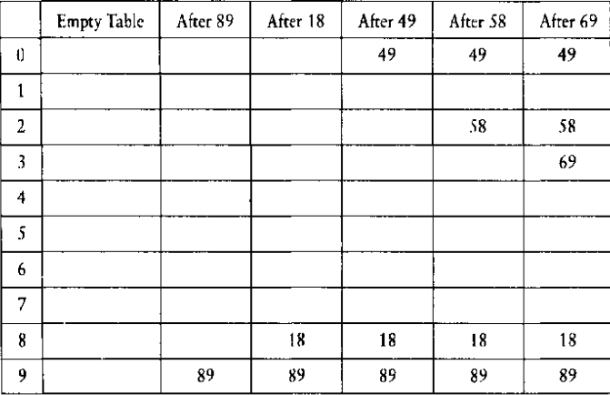
Quadratic Probing
Quadratic probing: if there is a collision at hash address h, probes the table at locations h + 1, h + 2², h + 3², …, that is, at locations h + i² (mod hashsize) for i = 1,2,…
The array should be considered circular.
Example: Inserting keys {89, 18, 49, 58, 69}, hash function h(k) = k mod 10.

Slide 26
Deletion
How to delete entries from a hash table? Just making the deleted location empty?
Suppose we want to retrieve a key, we will look at the hash address and the probe sequence until the key is found or an empty location is reached. In the later case, the retrieval is unsuccessful.
So just mark a deleted location empty will not work.
One solution is to invent another special key that signals a deleted position, and this is empty for insertion but “not empty” for retrieval.

Slide 27
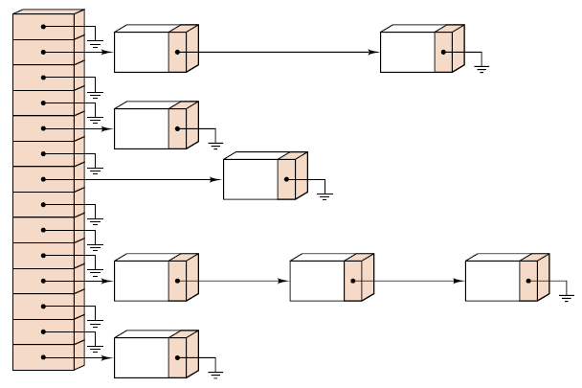
Chaining
Idea: When there is a collision, the synonym (同义) is put into a linked list of synonyms.
A linked list of synonyms

Slide 28
Chaining Example
基本思想：将具有相同哈希地址的记录链成一个单链表，m个哈希地址就设m个单链表，然后用一个数组将m个单链表的表头指针存储起来，形成一个动态的结构。
例：设{ 47, 7, 29, 11, 16, 92, 22, 8, 3, 50, 37, 89，10 }的哈希函数为：
Hash(key)= key mod 11，
注：有冲突的元素可以插
在表尾,也可以插在表头。
0
1
2
3
4
5
6
7
8
9
10
22
11
<
89
<
<
3
47
<
37
92
<
16
<
50
<
29
7
<
8
<
<
10
<

Slide 29
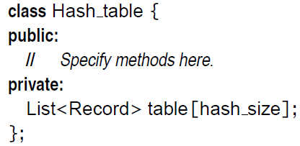
Performance of Chaining
If the records are large, a chained hash table can save space.
Collision resolution with chaining is simple; clustering is no problem.
The hash table itself can be smaller than the number of records; overflow is no problem.
Deletion is quick and easy in a chained hash table.
If the records are very small and the table nearly full, chaining may take more space.

Slide 30


The Birthday Surprise
The probability that m people all have different birthdays is
This expression becomes less than 0.5 whenever m>=23.
For hashing, the birthday surprise says that for any problem of reasonable size, collisions will almost certainly occur.

Slide 31
Analysis of Hashing
We count the number of probes(探查): one comparison of a key with the target.
This number will depends on how full the table is, the load factor λ (负载因子).
The load factor of a table is λ = n/t, n is the number of entries in the table and t the size of the array.
λ can be seen as the average length of the chains.
Open addressing: λ ≤ 1
Chaining: there is no limit for λ.

Slide 32

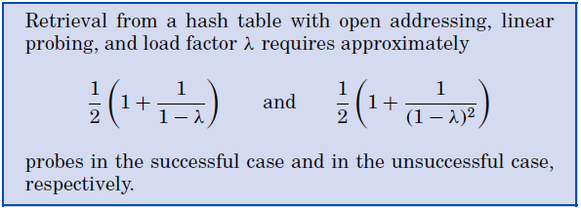
Analysis of Hashing

Slide 33
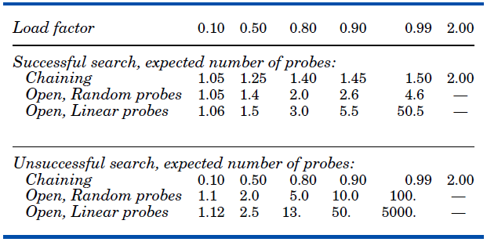
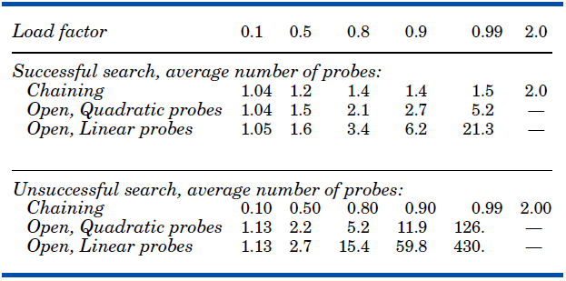
Analysis of Hashing
Theoretical comparisons:
Empirical comparisons:

Slide 34
Conclusions: Comparison of Methods
Sequential search is O(n)
Sequential search is the most flexible method. The data may be stored in any order, with either contiguous or linked representation.
Binary search is O(log n)
Binary search demands more, but is faster: The keys must be in order, and the data must be in random-access representation (contiguous storage).
Hash-table retrieval is O(λ)=O(1).
Hashing requires the most structure, a peculiar ordering of the keys well suited to retrieval from the hash table, but generally useless for any other purpose.

Slide 35

Thank you!

